Slide 1
Numerical Analysis (6/7) Linear systems
University of Luxembourg - 2024
Master in Mathematics
Hadrien Beriot

Slide 2
Outline
1. Introduction
2. Direct Methods
3. Iterative methods
4. Summary

Slide 3

1. Introduction

Slide 4
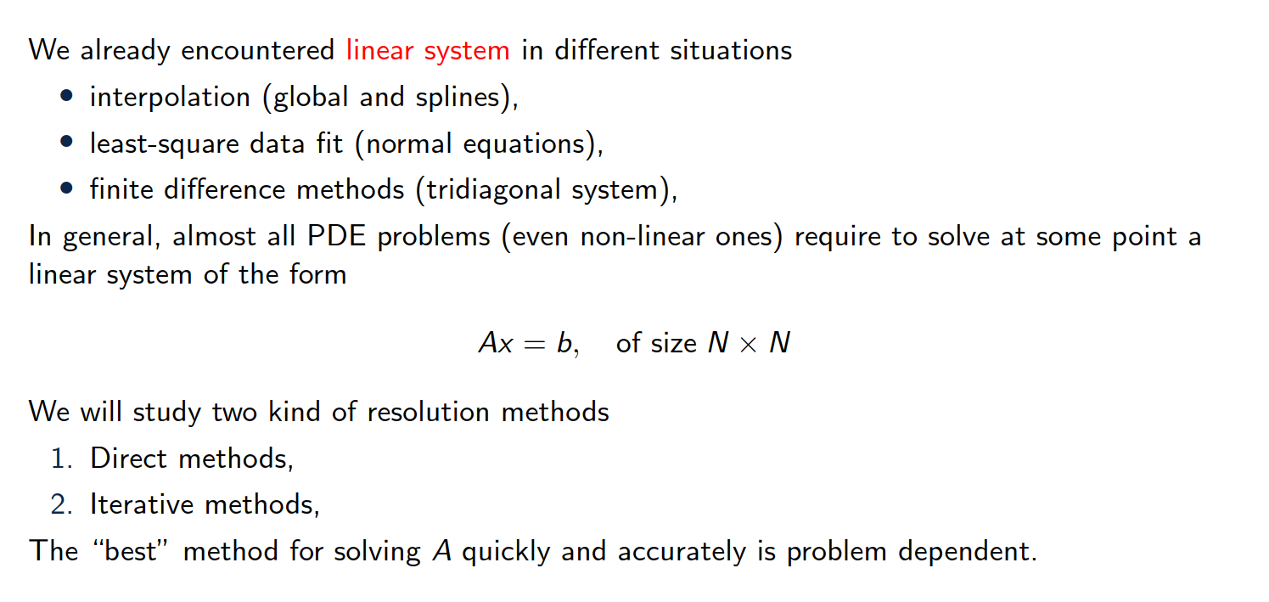
Overview of the content
Notes:
The image represents a Lorenz attractor, which is a three-dimensional chaotic attractor discovered by the mathematician Edward Lorenz.
The Lorenz attractor is a graphical representation of the solutions to a set of differential equations that describe a simplified model of atmospheric convection, known as the "Butterfly effect".
The image shows the characteristic butterfly-like shape of the Lorenz attractor, which demonstrates the sensitive dependence on initial conditions that is a hallmark of chaotic systems.

Slide 5
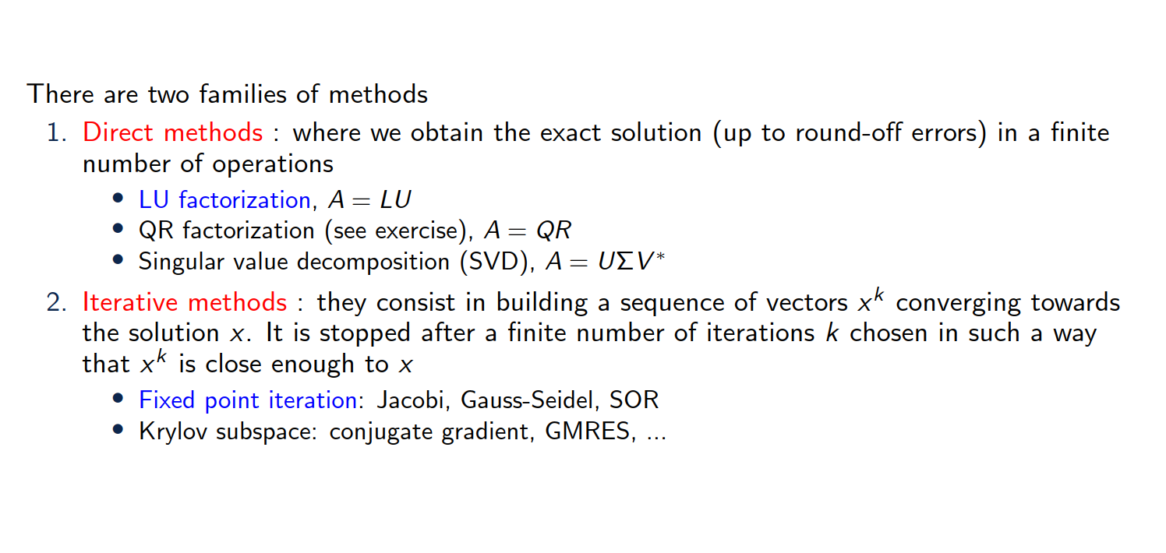
Overview of the content

Slide 6
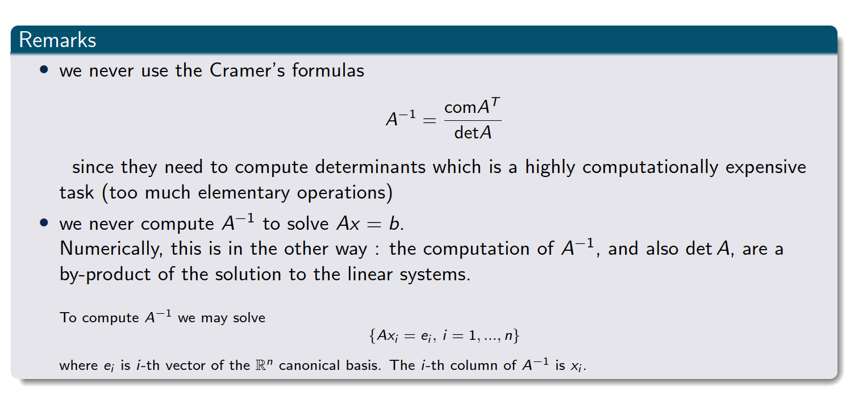
Important remarks
Notes:
The comatrix of a matrix AAA is the transpose of the matrix of cofactors of AAA.Each cofactor is obtained by calculating the determinant of the submatrix that remains after removing the row and column corresponding to the element in question, with an appropriate sign adjustment based on the position.

Slide 7
2. Direct methods

Slide 8
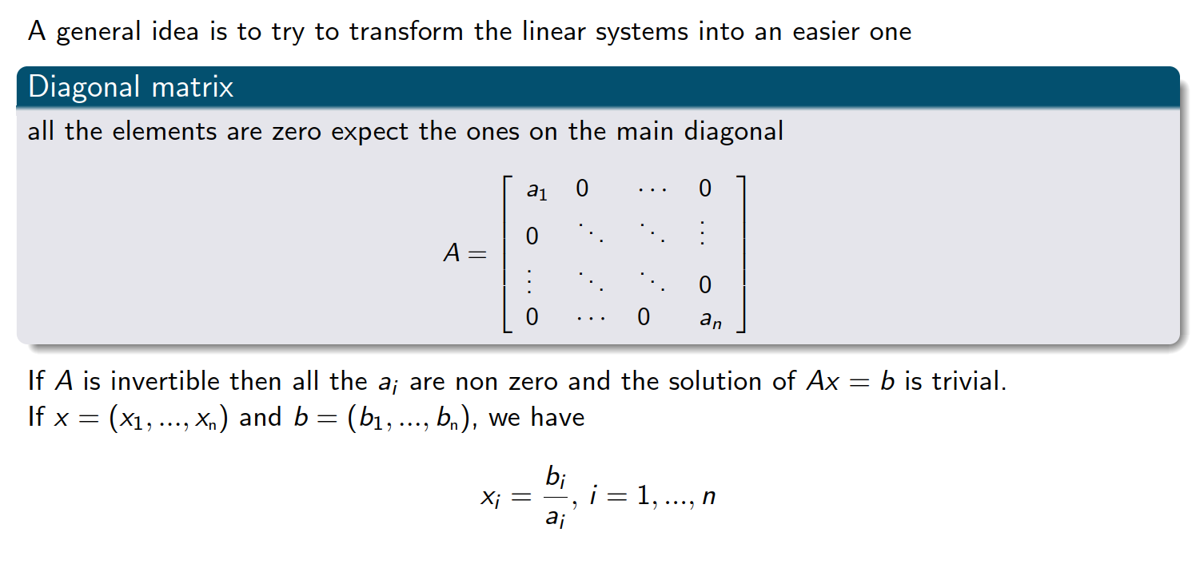
Linear system that is easy to solve

Slide 9
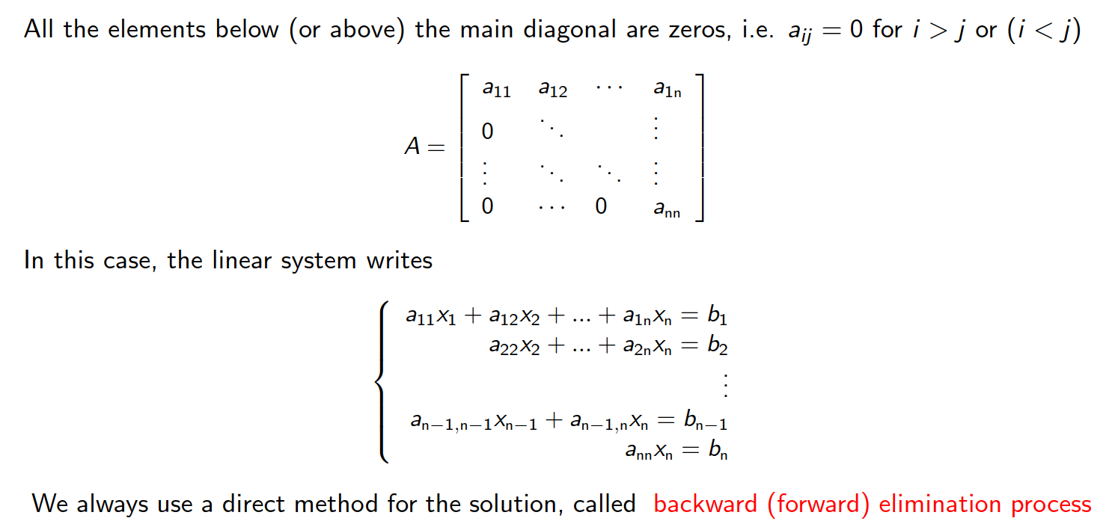
Upper (or lower) triangular matrices

Slide 10
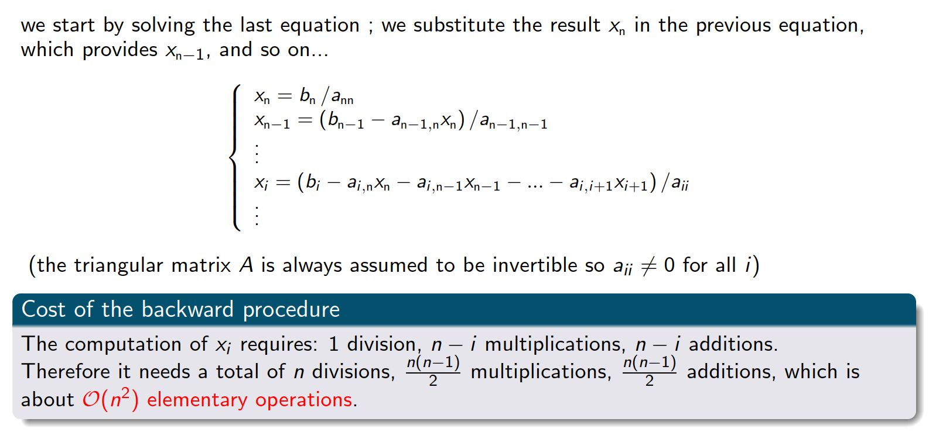
Backward substitution
Exercise 1

Slide 11
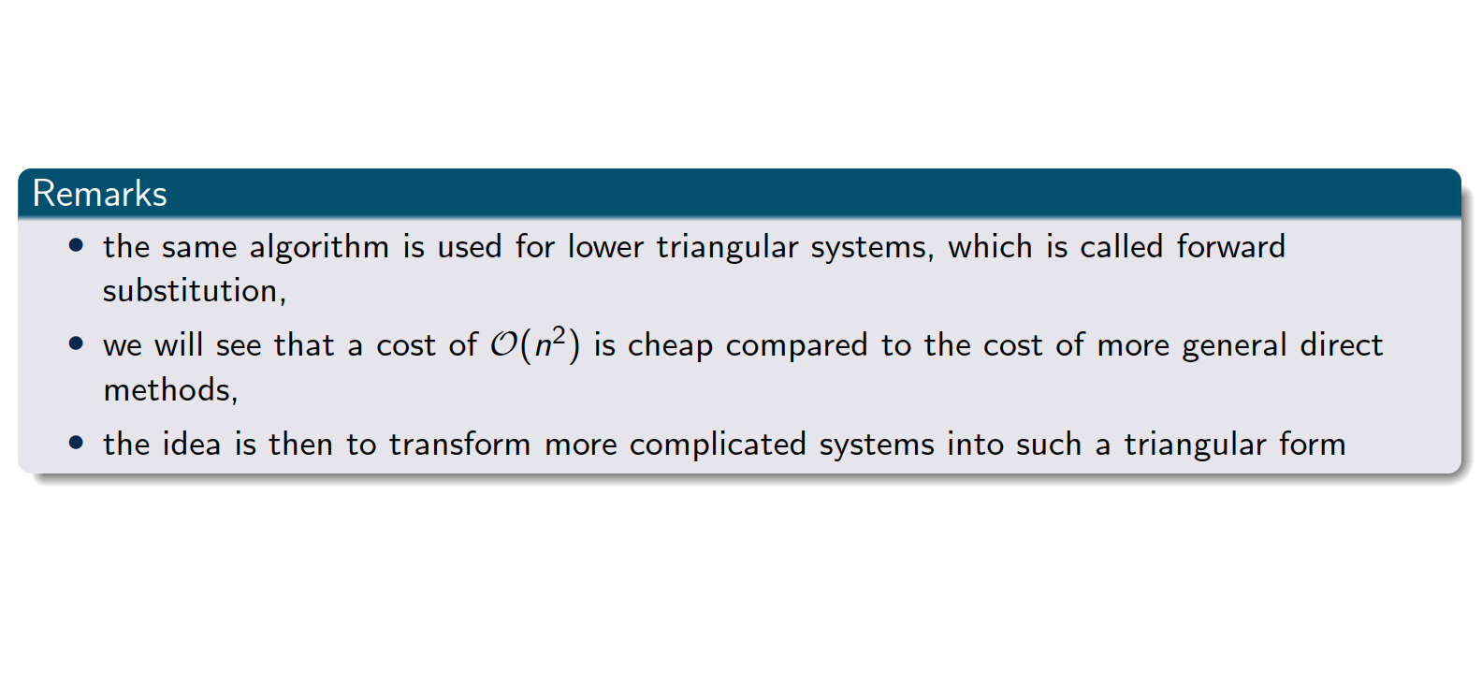
Upper (or lower) triangular matrices

Slide 12
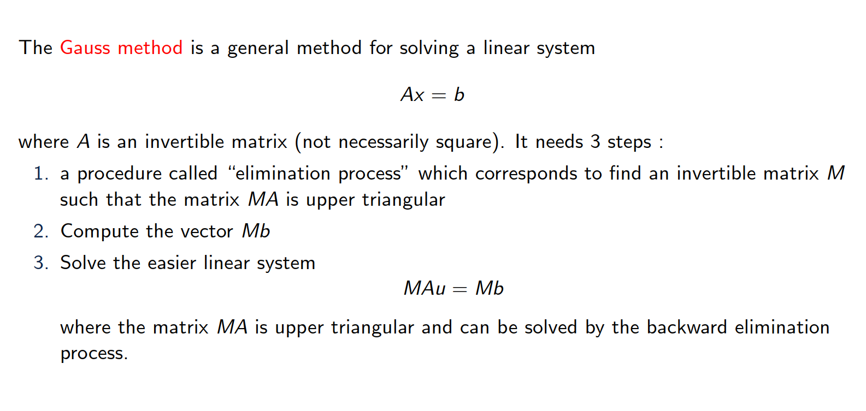
Gauss elimination

Slide 13
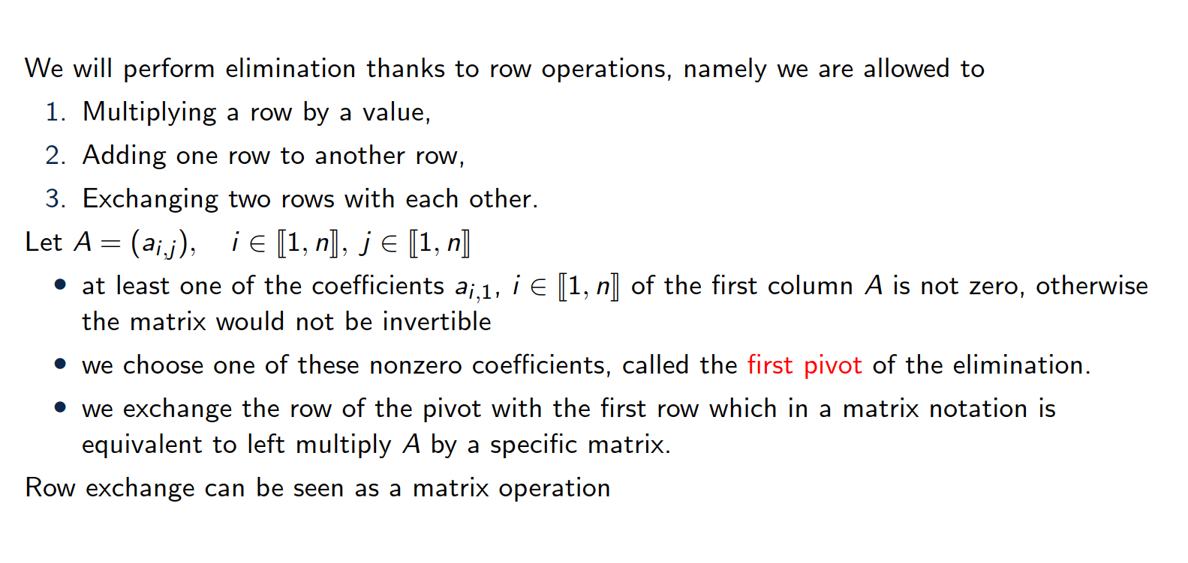
Description of the first step

Slide 14
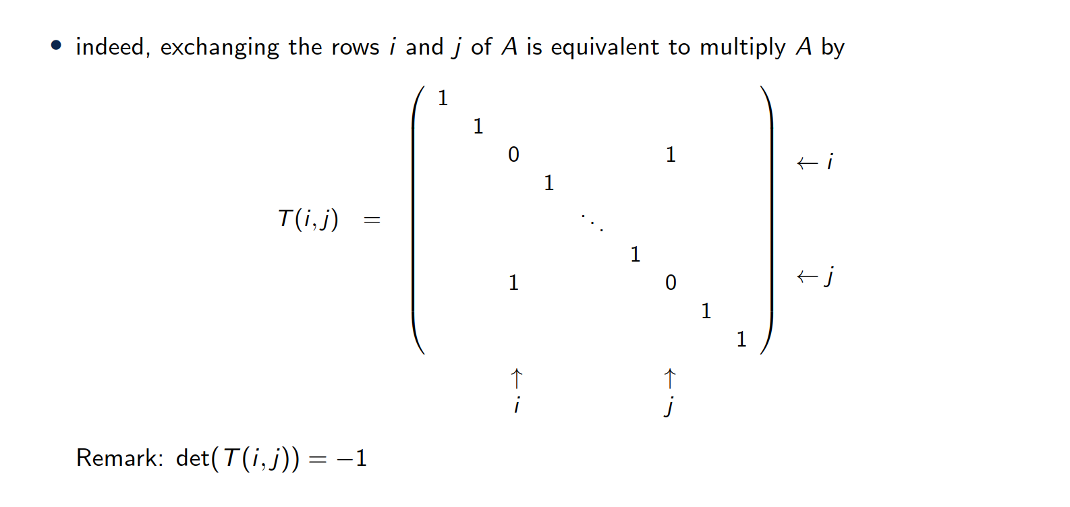
Description of the first step - Row exchange

Slide 15
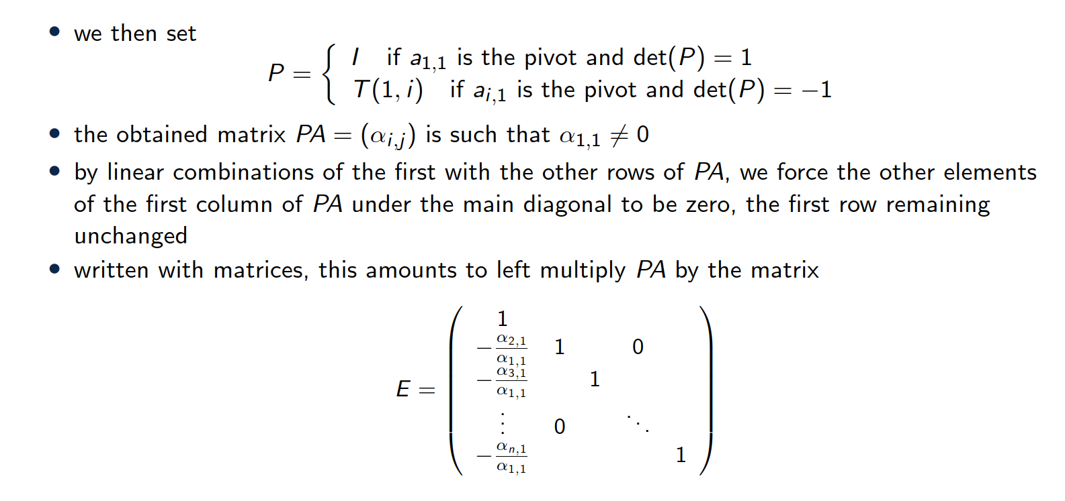
Description of the first step - scaling and adding rows

Slide 16
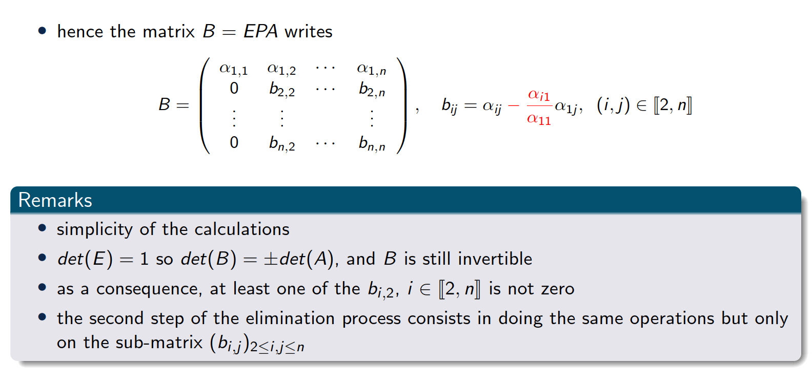
Description of the 1st step

Slide 17
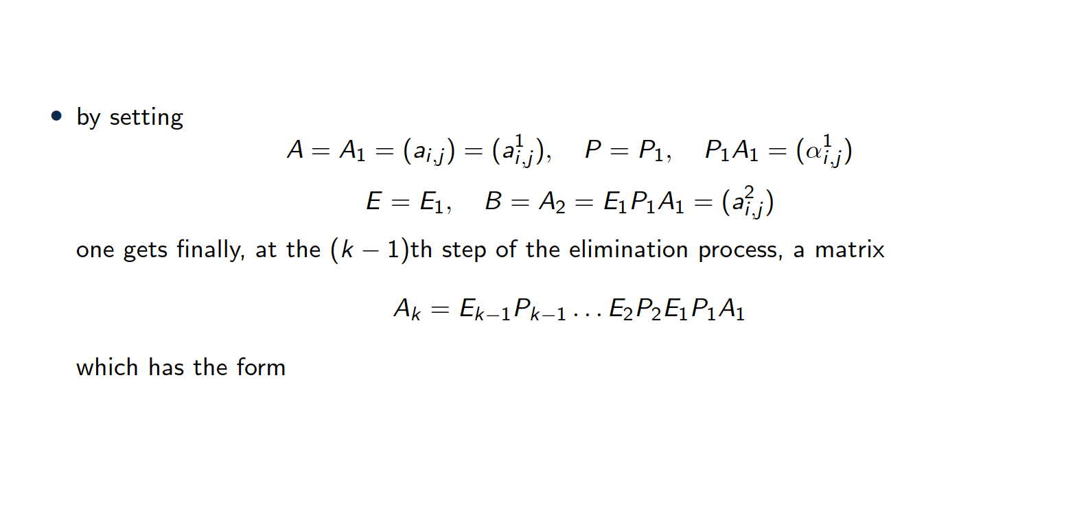
Description of the kth step

Slide 18
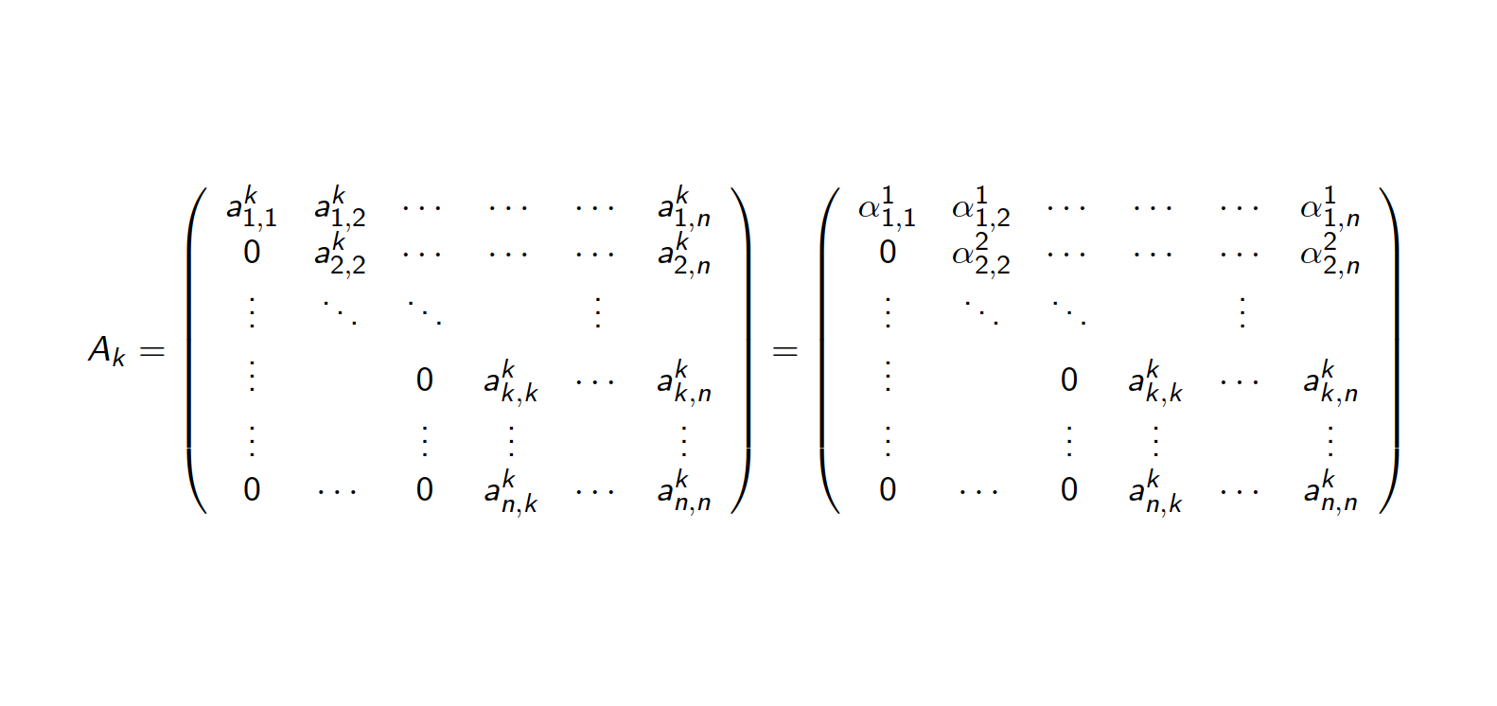
Description of the kth step

Slide 19
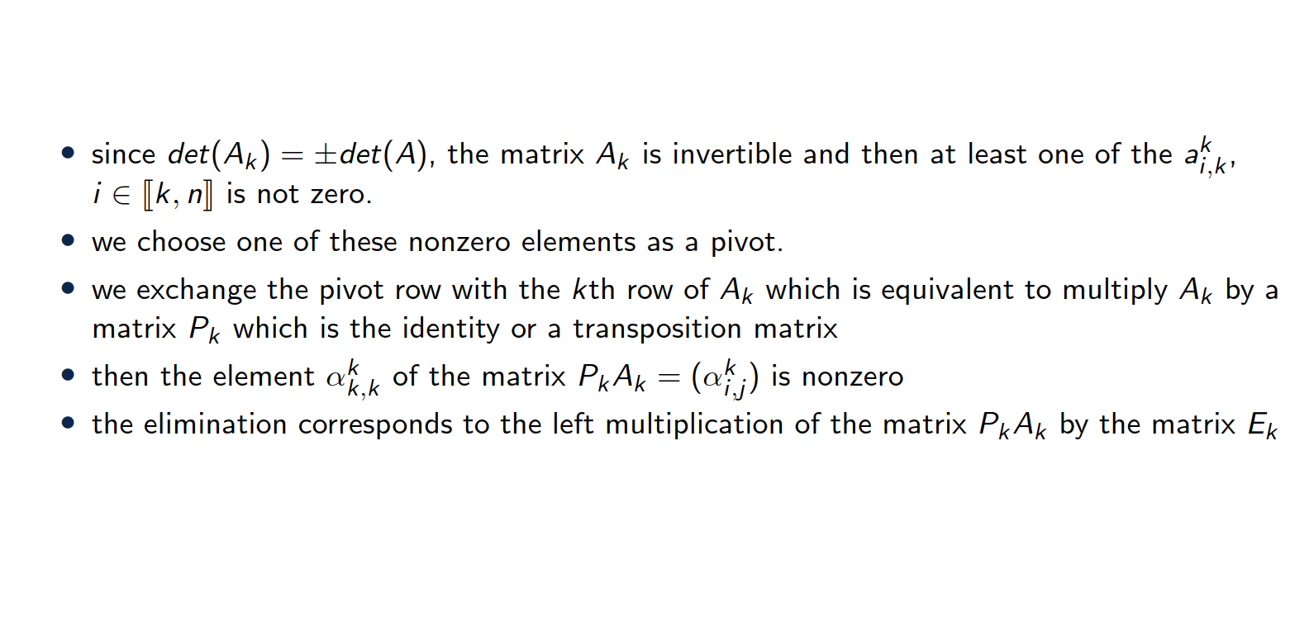
Description of the kth step

Slide 20
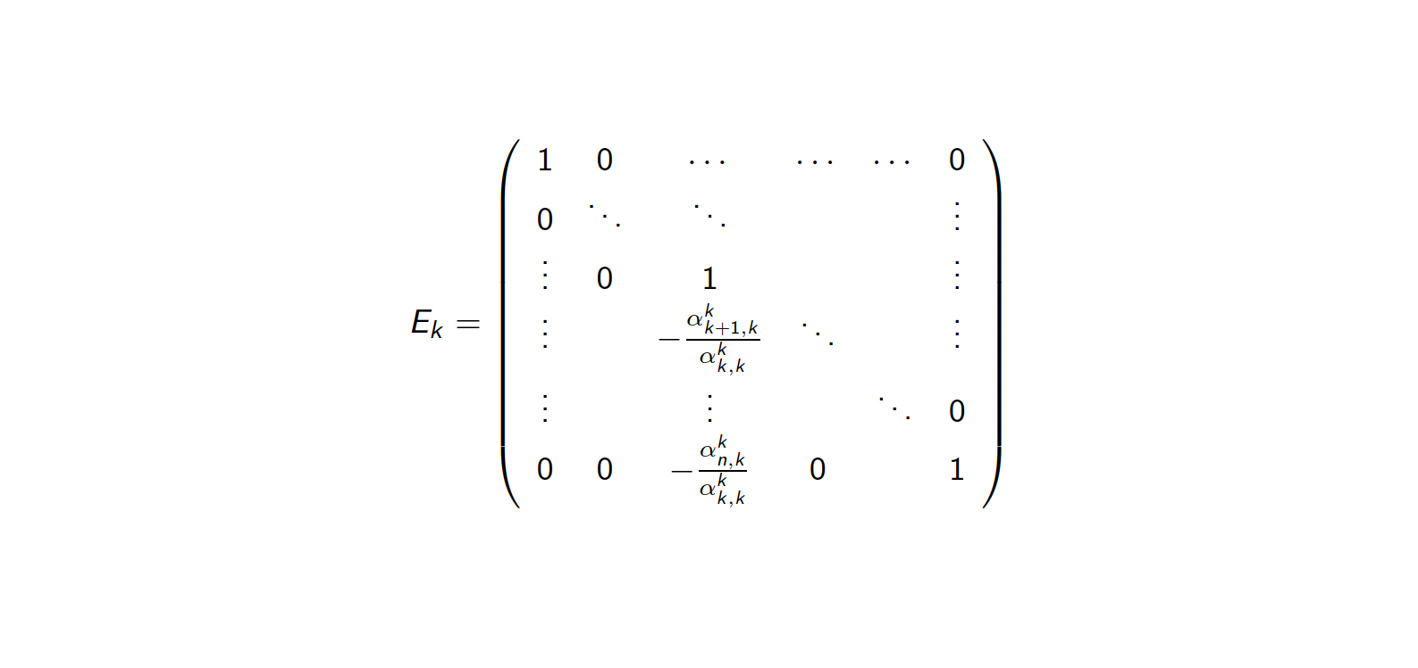
Elimination matrix at kth step

Slide 21
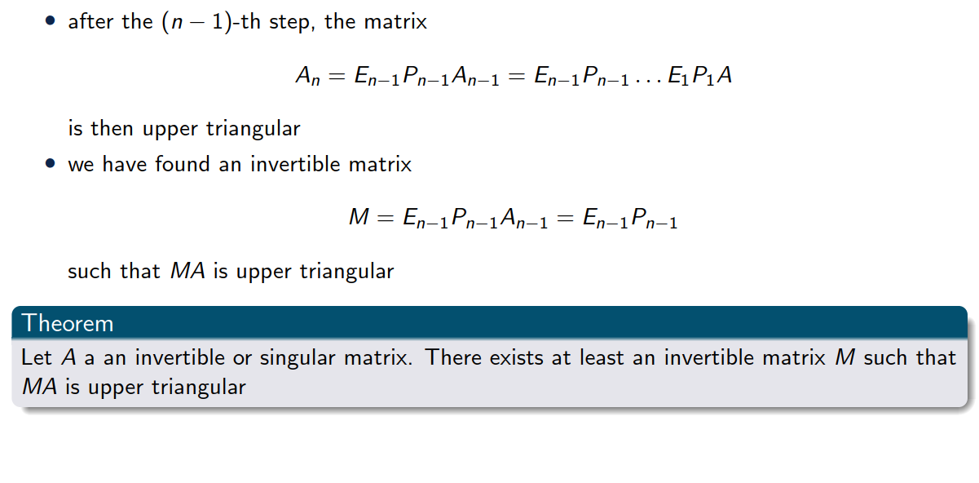
In the end…

Slide 22
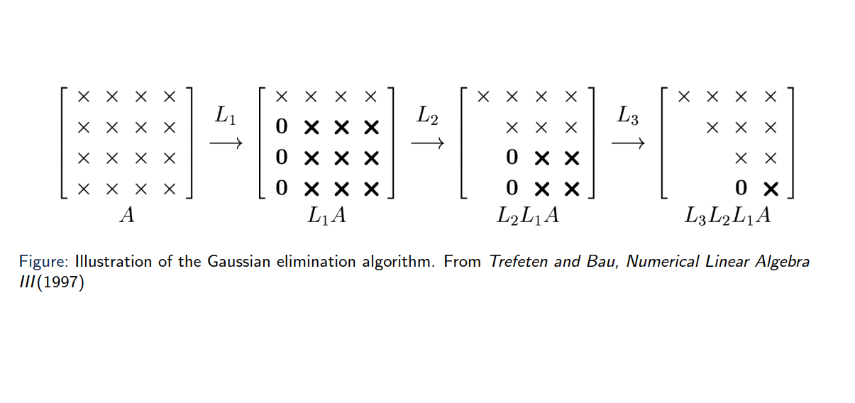
Illustration of the algorithm

Slide 23
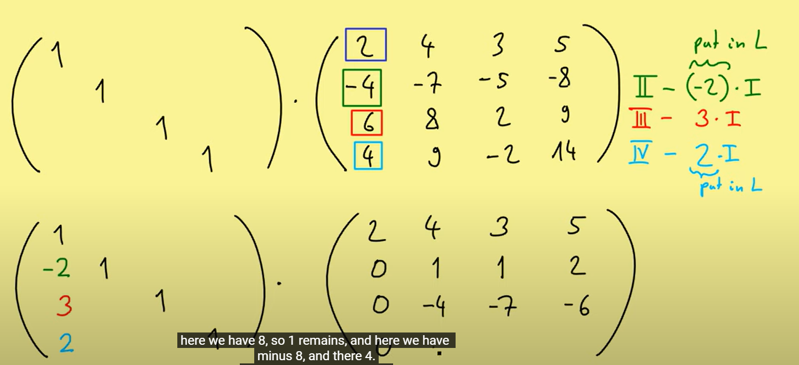
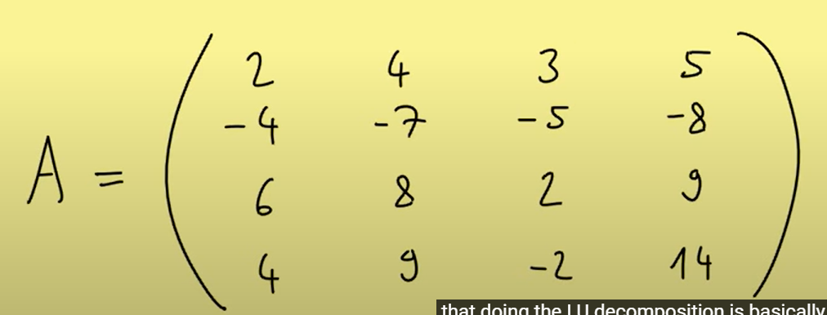
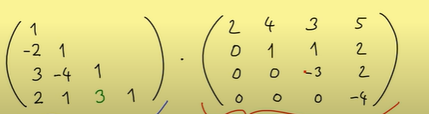
Example 4x4 linear system
https://www.youtube.com/watch?v=BFYFkn-eOQk
Notes:
Expanded Gaussian elimination

Slide 24
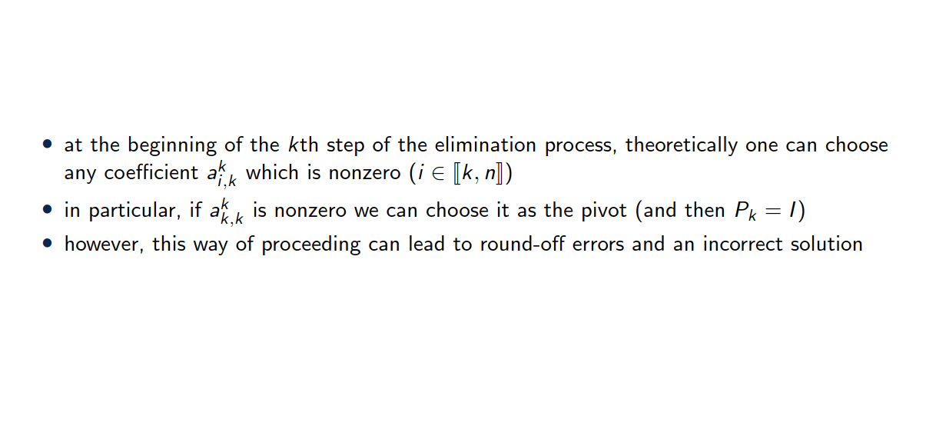
Choice of the pivot

Slide 25
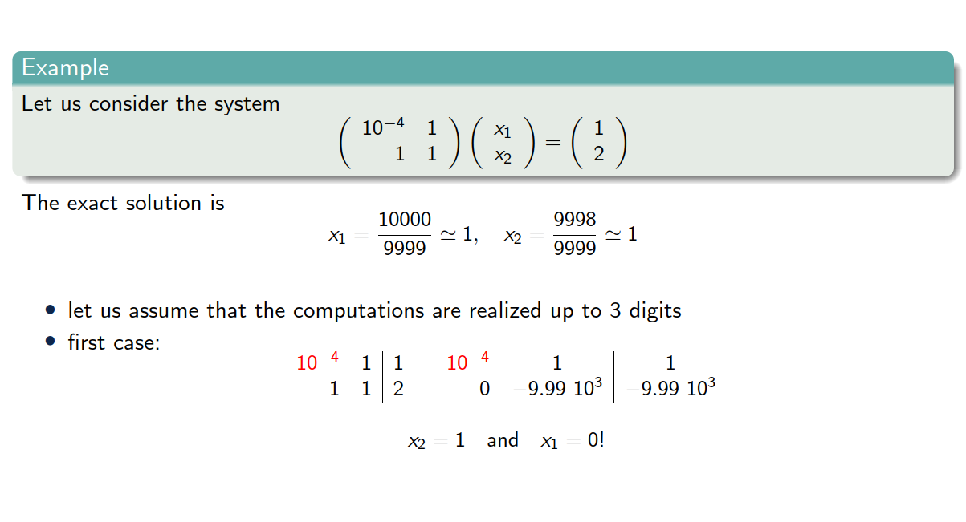
Choice of the pivot

Slide 26
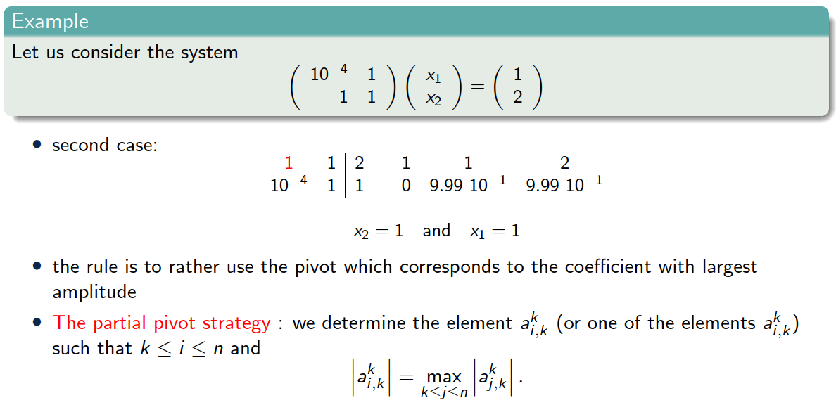
Choice of the pivot

Slide 27
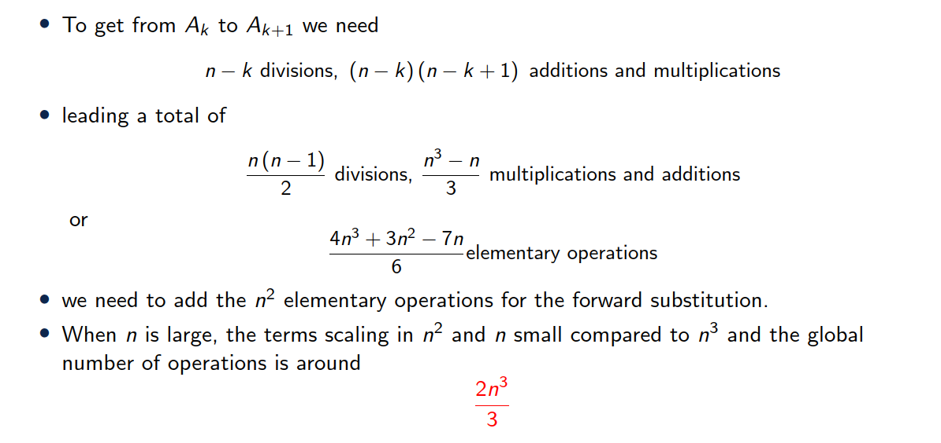
Cost of Gauss method

Slide 28
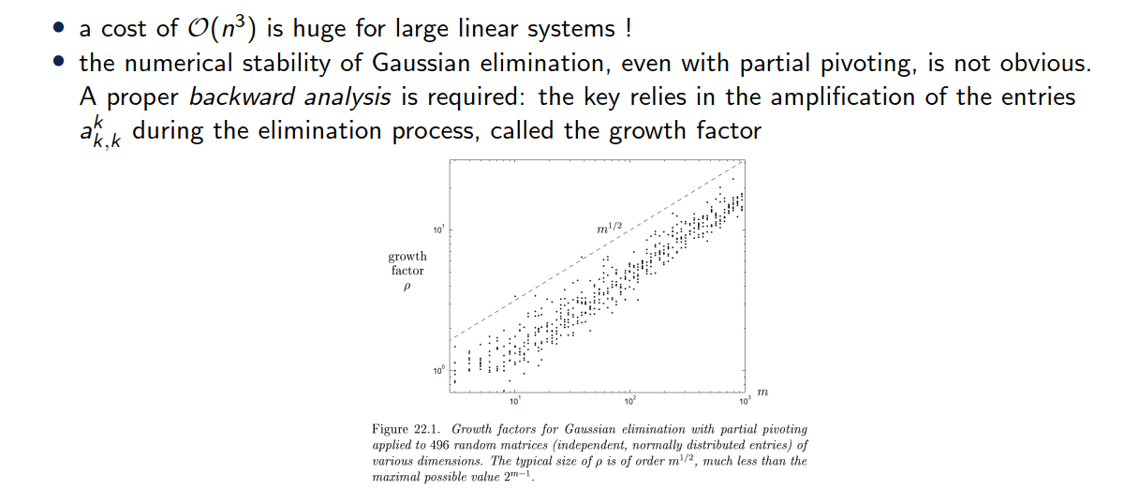
Remarks

Slide 29
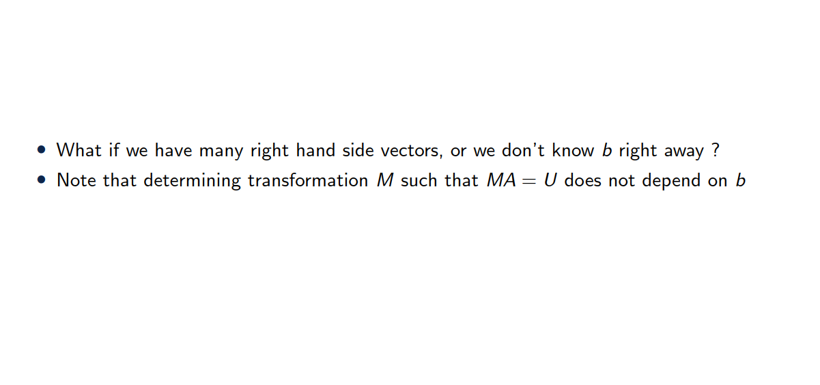
Remarks

Slide 30
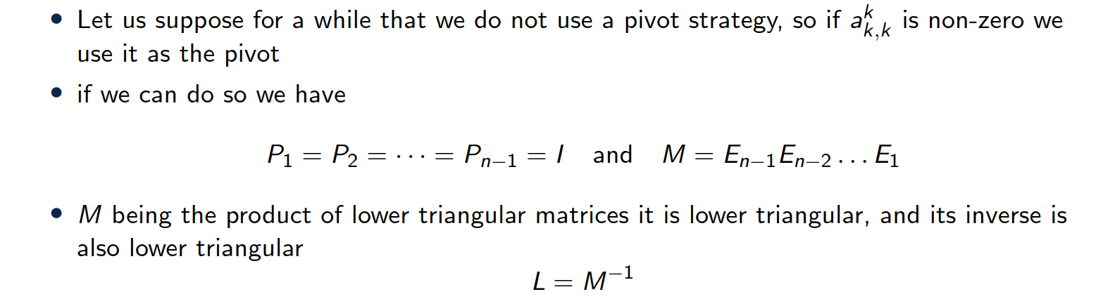
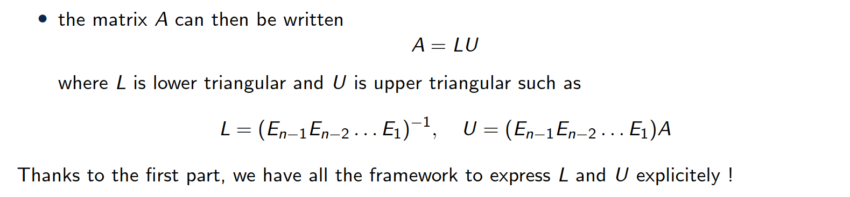
LU factorization

Slide 31
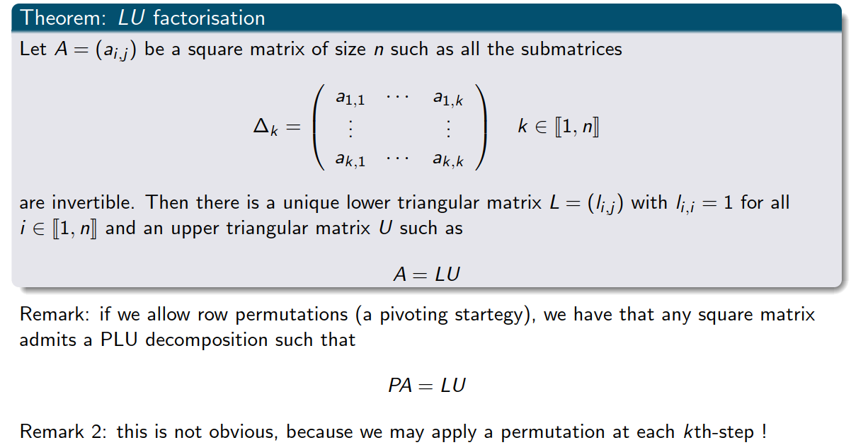
Theorem

Slide 32
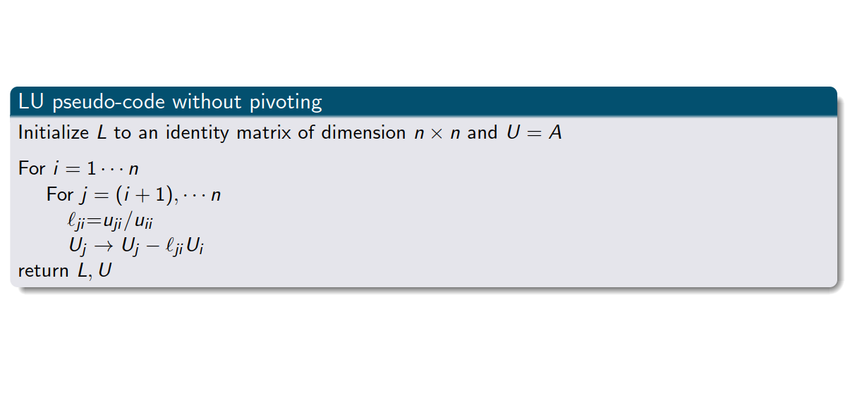
LU factorization pseudo-code

Slide 33
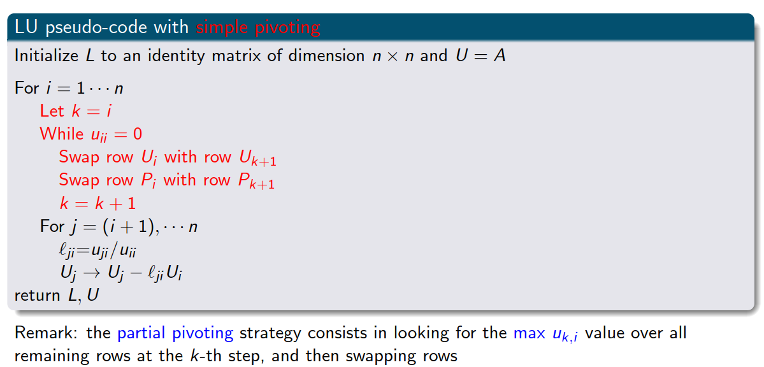
LU factorization pseudo-code with pivoting

Slide 34
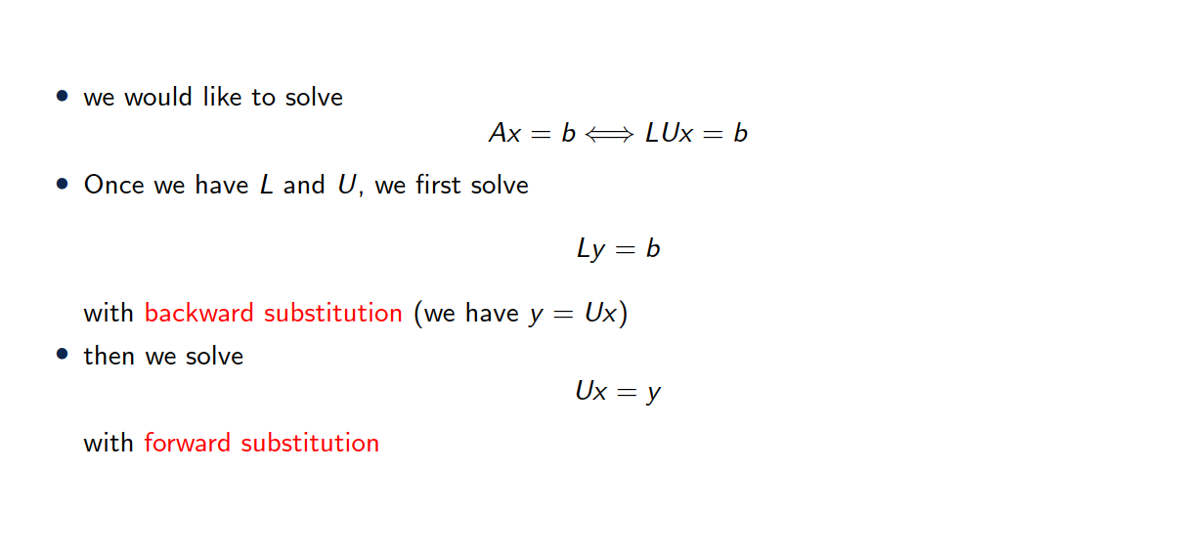
Solving a linear system with LU factorization

Slide 35
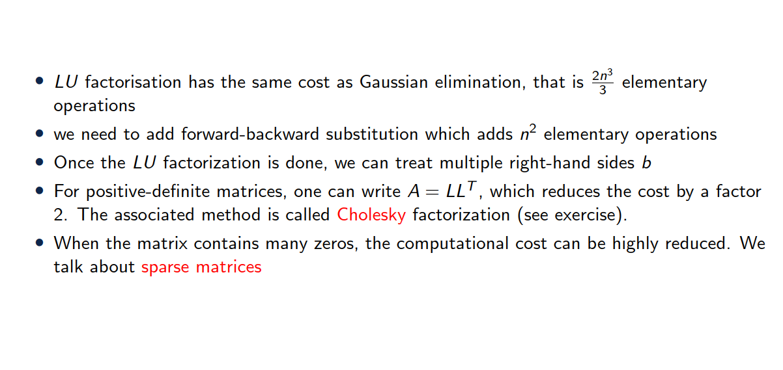
Factorization cost

Slide 36
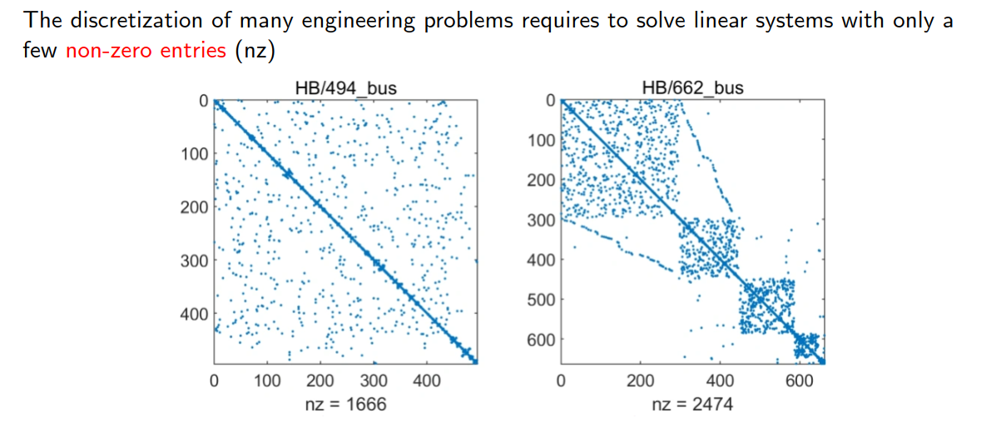
A few words on sparse matrices

Slide 37
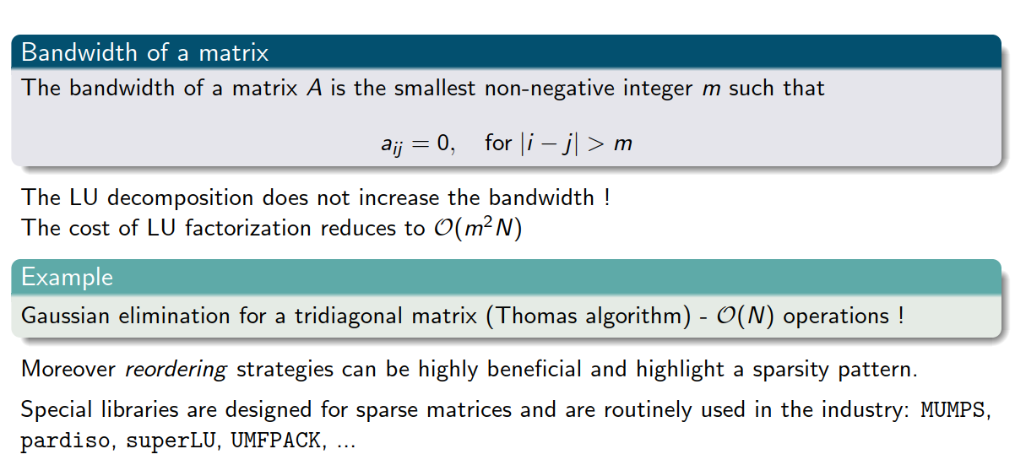
A few words on sparse matrices

Slide 38
3. Iterative solvers

Slide 39
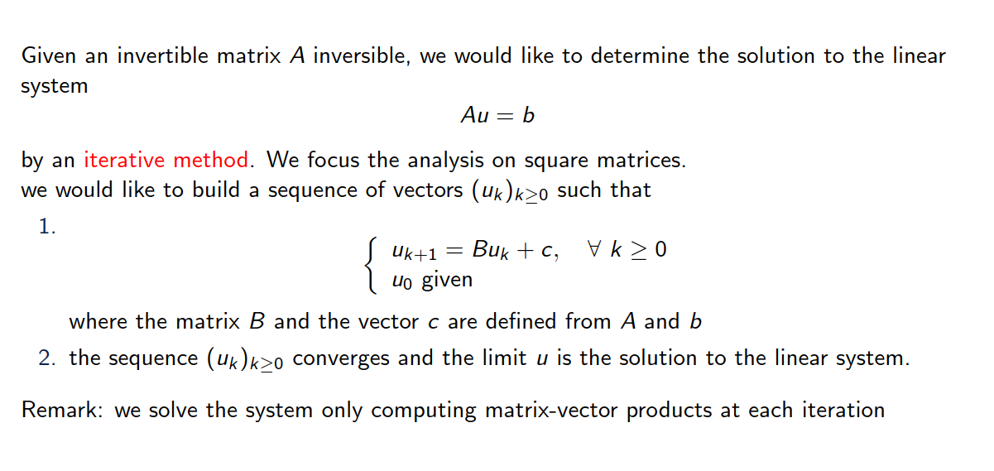
Introduction

Slide 40
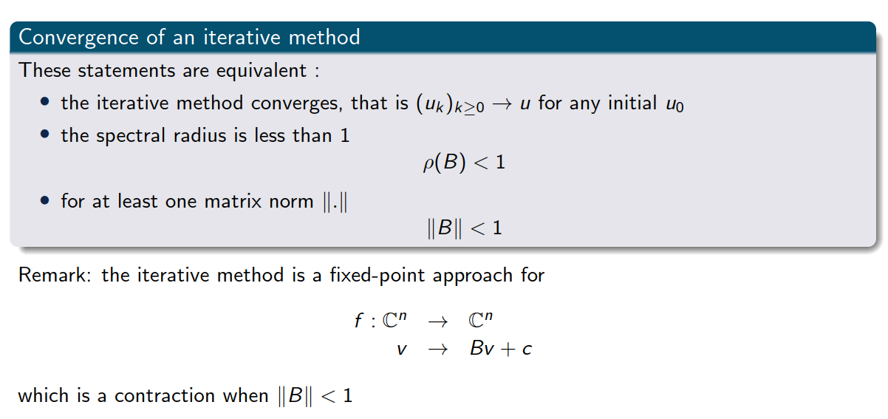
Some basic notions

Slide 41
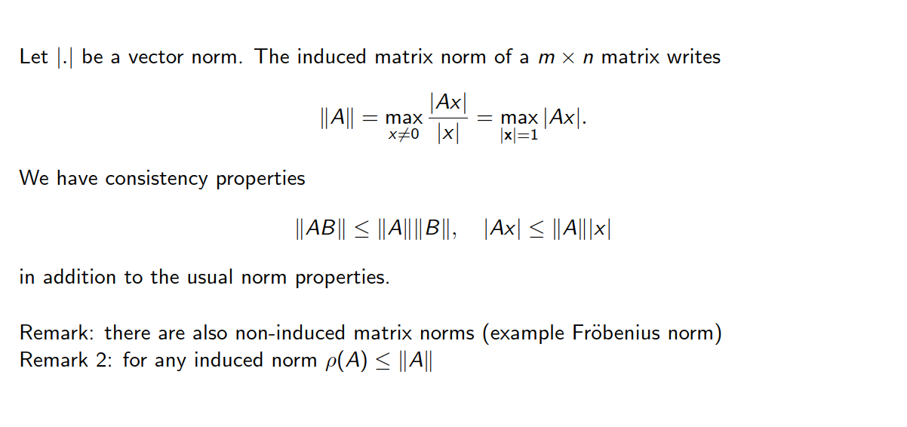
A few notes on matrix norms and spectral radius

Slide 42
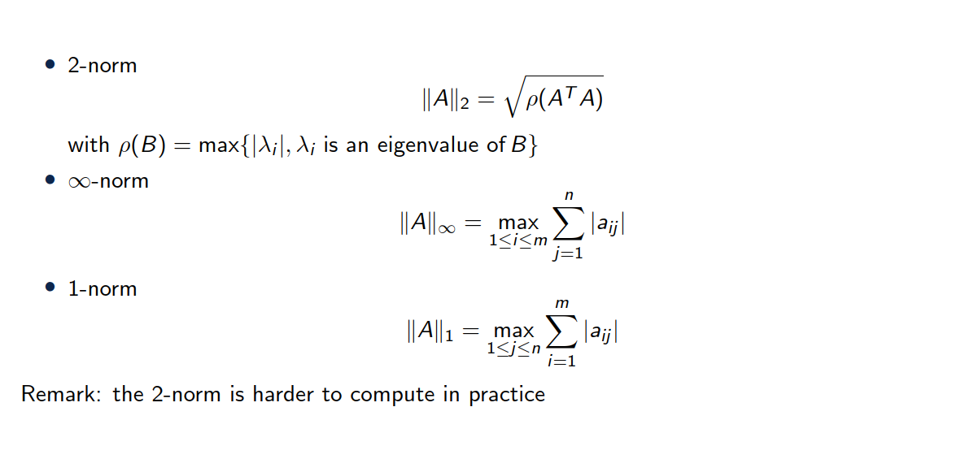
Some induced matrix norms

Slide 43
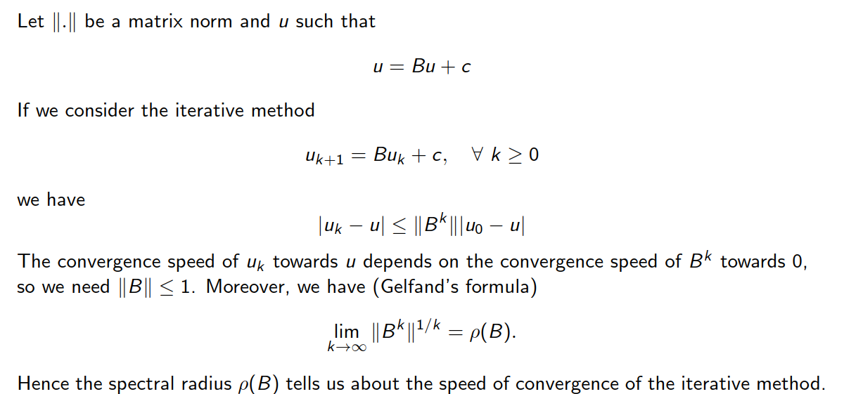
Speed of convergence

Slide 44
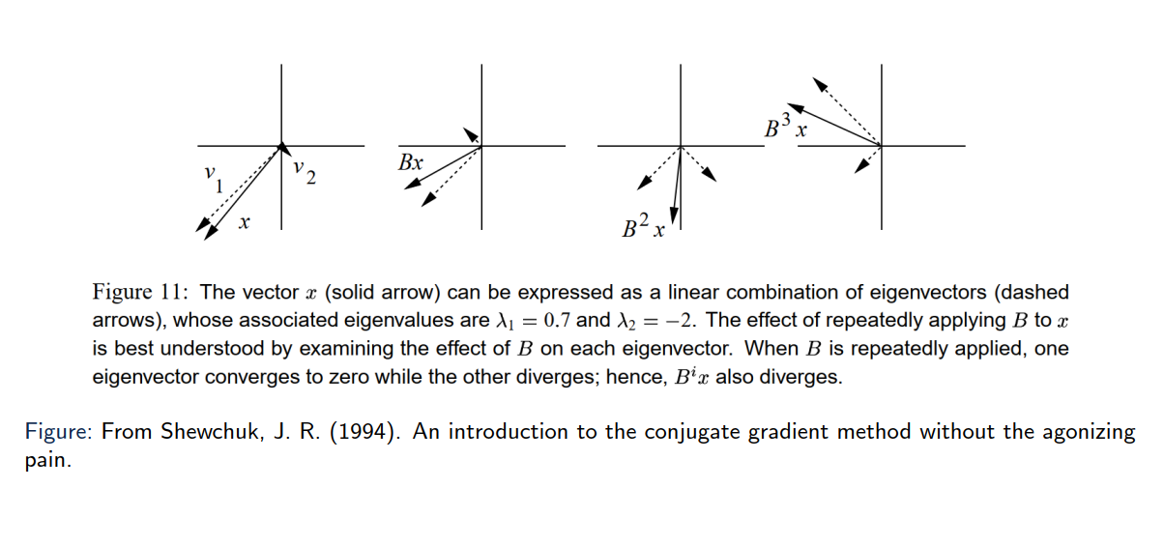
Some basic notions
Eigen vectors only get scaled, not changed in direction!

Slide 45
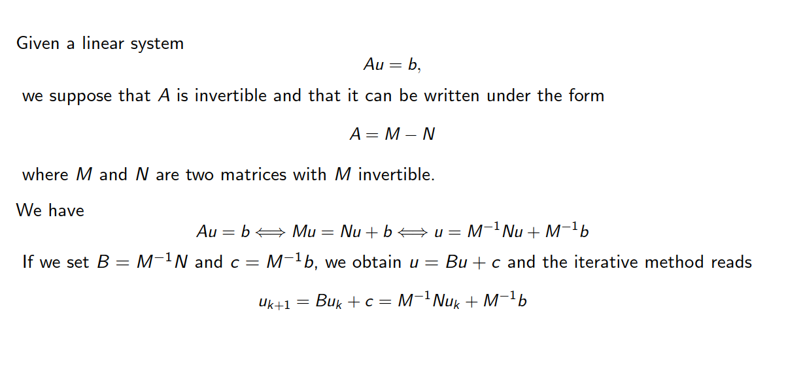
Another matrix decomposition

Slide 46
Some basic notions

Slide 47
Some basic notions

Slide 48
Some basic notions

Slide 49
Some basic notions

Slide 50
Some basic notions

Slide 51
6. Summary

Slide 52
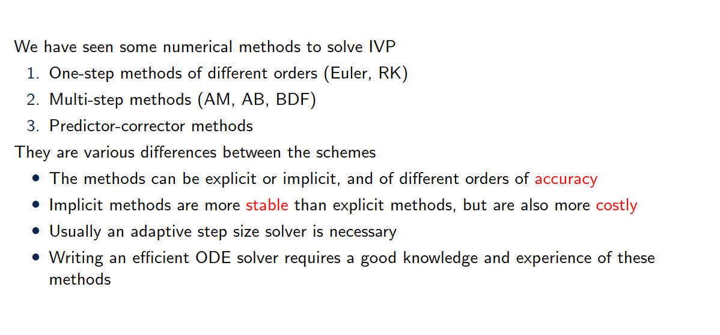
Summary

